Slide 1
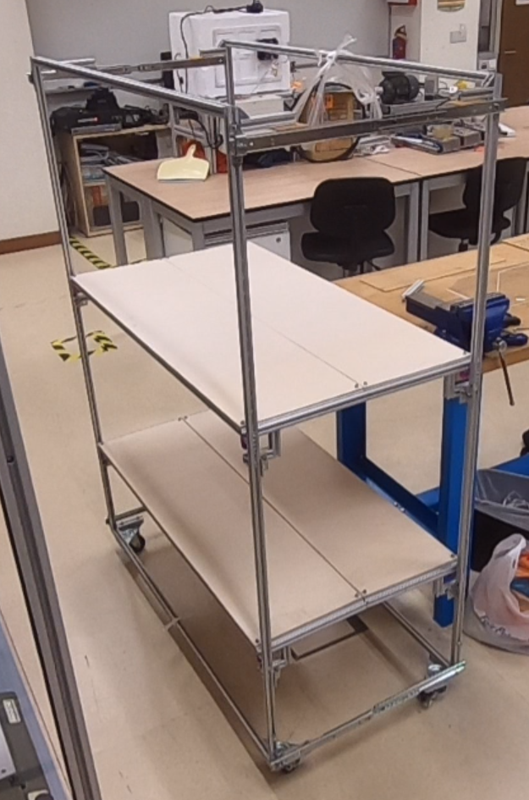
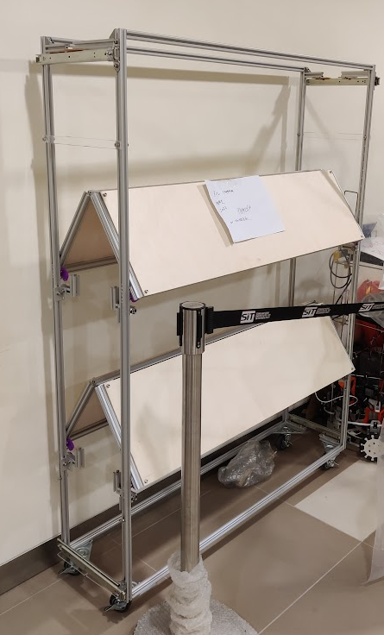
The collapsible cart
Features:
Able to become 40% smaller
On caster wheels
Adjustable shelf heights

